Slide 1


SMART INDIA HACKATHON 2025
TITLE PAGE
Problem Statement ID: SIH25102
Problem Statement Title: AI-based Drop-out Prediction And Counseling System
Theme: Smart Automation
PS Category: Software
Team ID:
Team Name: Code-Z

Slide 2

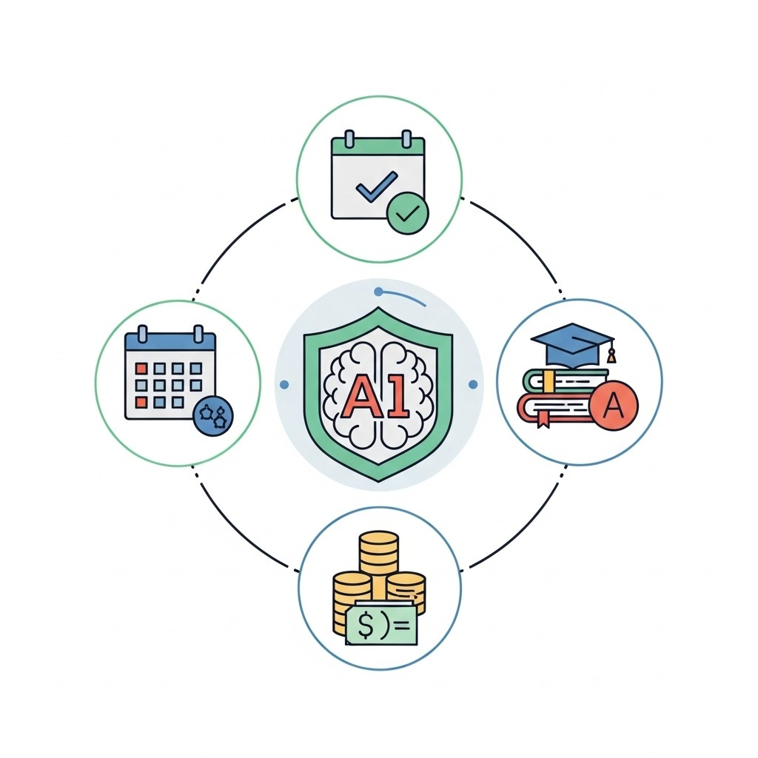

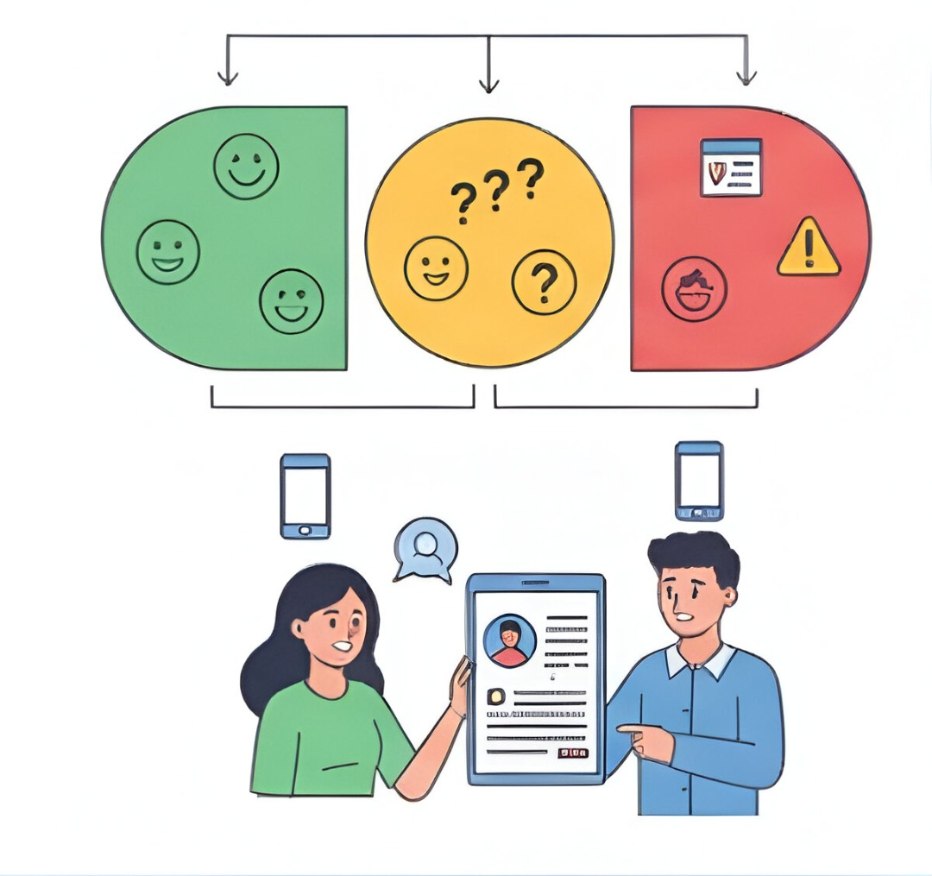



IDEA
Code-Z
Problem resolution:
The system classifies students as high, medium, or low risk using ML on attendance, test scores, and fee data, and provides clear reasons with suggested counseling steps. Mentors retain full control, supported by timely notifications and a secure, cost-effective solution.
Idea / Solution:
Risk assessment using attendance, grades, fees, AI for early detection.
Automated mails to guardians for timely action.
Cost-effective, open-source, supports counselors’ decisions.
Innovation and Unique Solution:

Slide 3
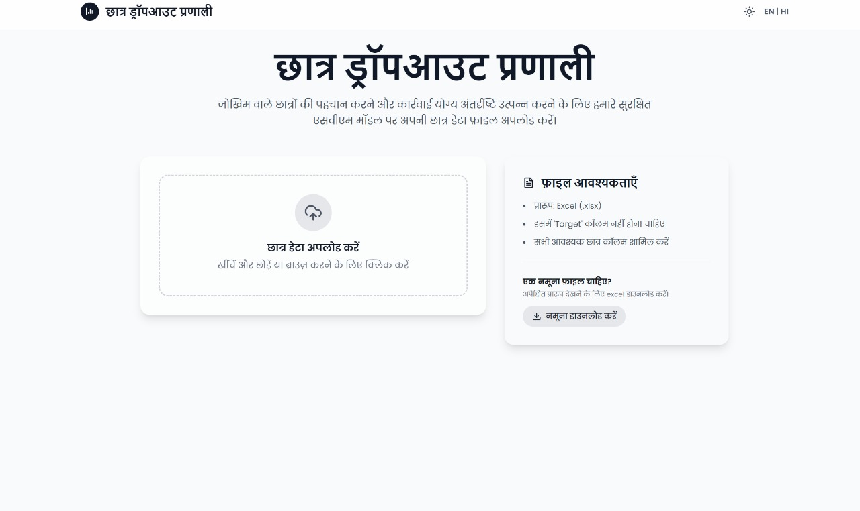
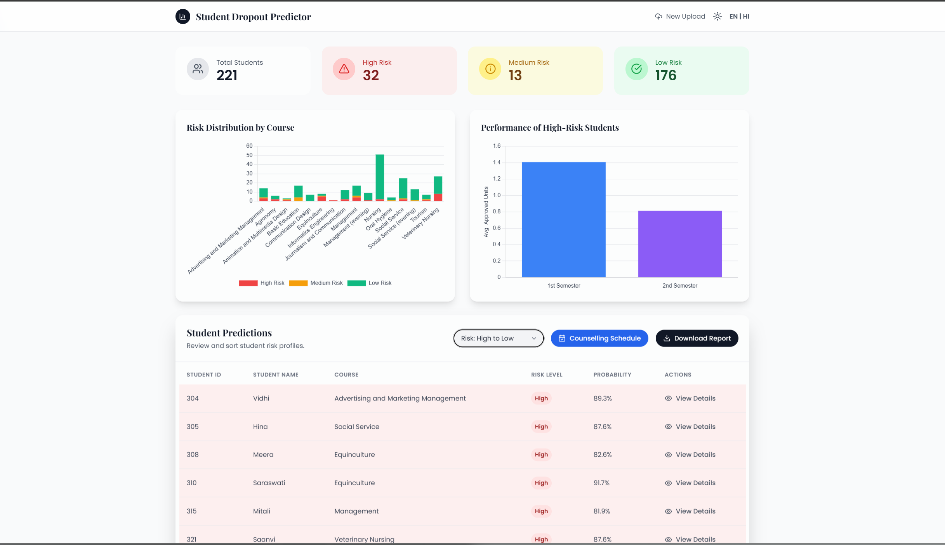
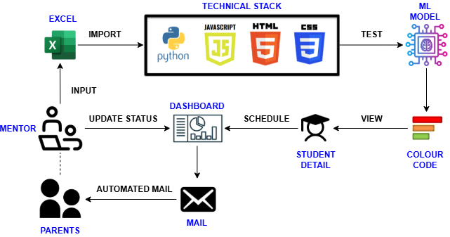
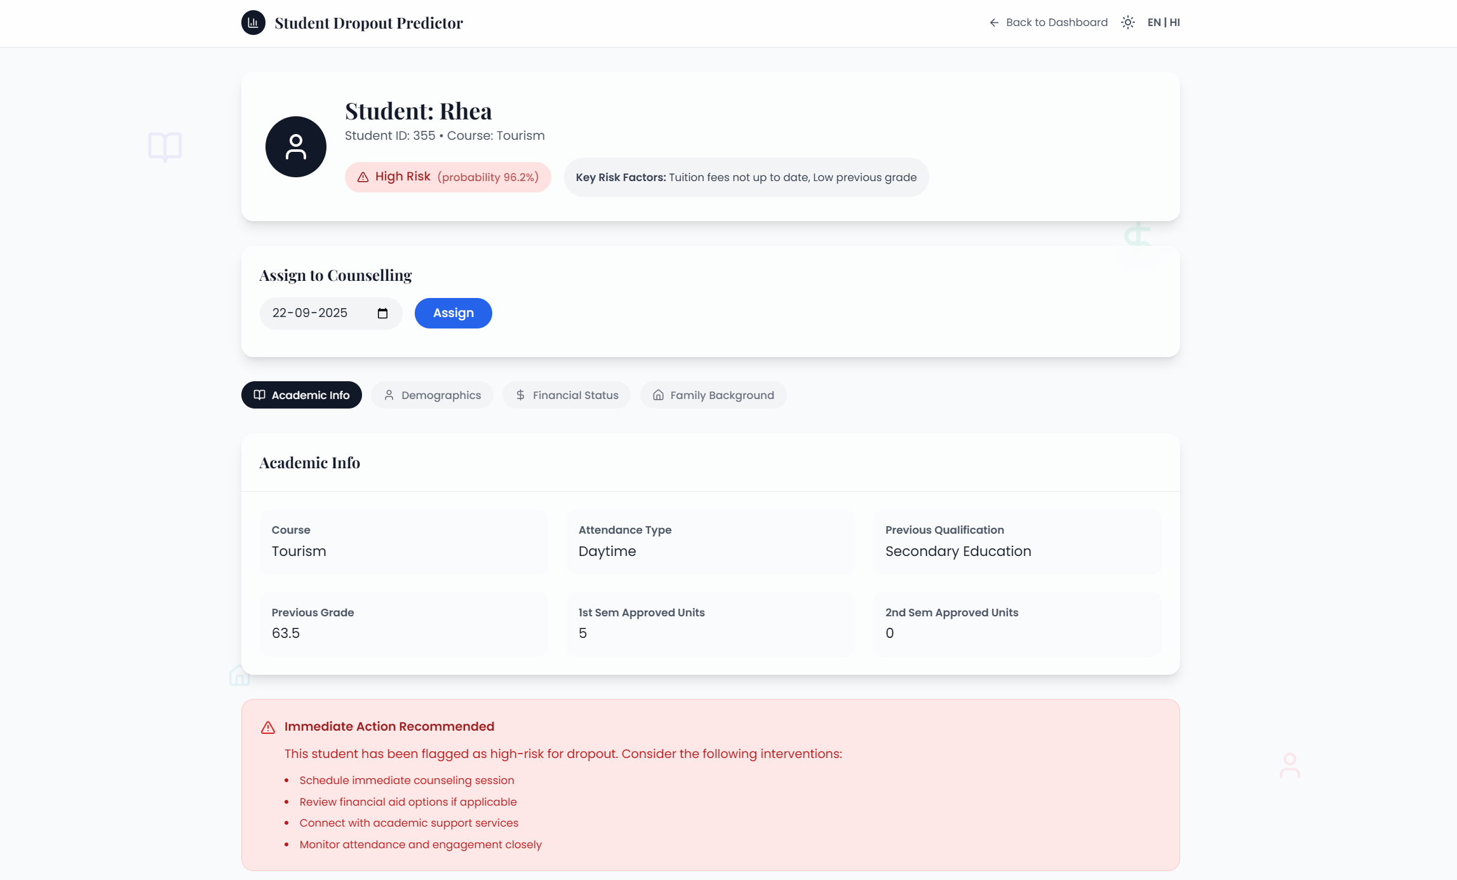
TECHNICAL APPROACH
Code-Z
Code-Z
Technologies to be used:
Programming Languages: Python (backend, ML), JavaScript (frontend)
Frameworks: Flask (Python web framework), HTML & CSS (frontend design), JavaScript (client-side interactivity)
Machine Learning Technique: Support Vector Machine (SVM) for dropout prediction
APIs: REST APIs for data fetching, email and SMS notification integrations
Additional Tools: Jinja2 templating engine for rendering HTML pages, secure APIs for message and email sending

Slide 4





FEASIBILITY AND VIABILITY
Code-Z
Code-Z
Feasibility of the Idea
Leverages existing student data with
open-source AI/ML for a cost-effective,
scalable solution.
Identifies risk levels with clear
reasons and suggested steps, empowering
mentors.
Engages mentors and guardians through simple notifications for timely interventions.
Potential Challenges & Risks
Data quality issues – Incomplete or
inconsistent records may reduce accuracy.
Resistance to adoption – Mentors or
institutions may hesitate to trust AI.
Privacy & ethical concerns – Handling
sensitive student and family data.
Technical limitations – Rural schools may face low digital infrastructure.
Strategies for Overcoming Challenges
Ensure quality & trust – Implement data cleaning/validation pipelines
and conduct training workshops for mentors and staff.
Secure & accessible system – Adopt strict privacy protocols
(role-based access, anonymization) and design a lightweight, mobile-first
version for rural accessibility.

Slide 5
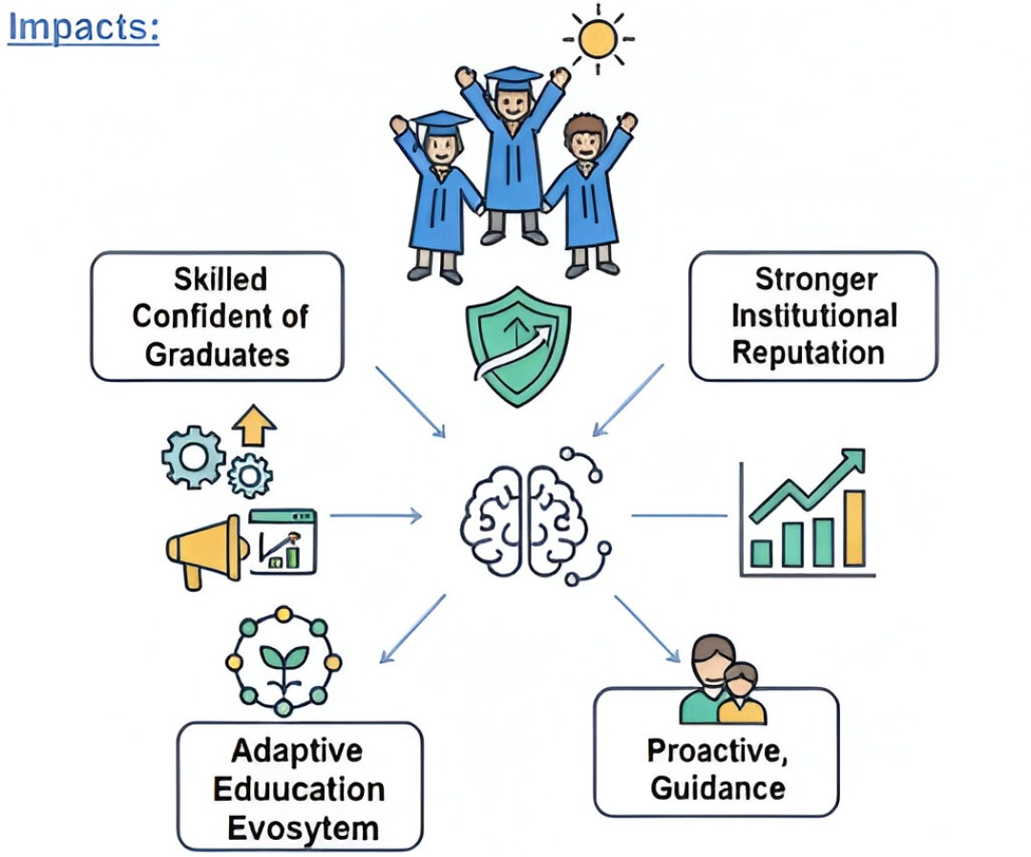




IMPACT AND BENEFITS
Code-Z
Code-Z
Benefits:
Early risk detection – Enables timely interventions to prevent failures or drop-outs.
Personalized support – Counselling with a unified dashboard of attendance, scores, and fees.
Automated & cost-effective – Alerts, reports, and uses existing data to improve retention.
Outcomes:
Adaptive, Education,
Ecosystem

Slide 6
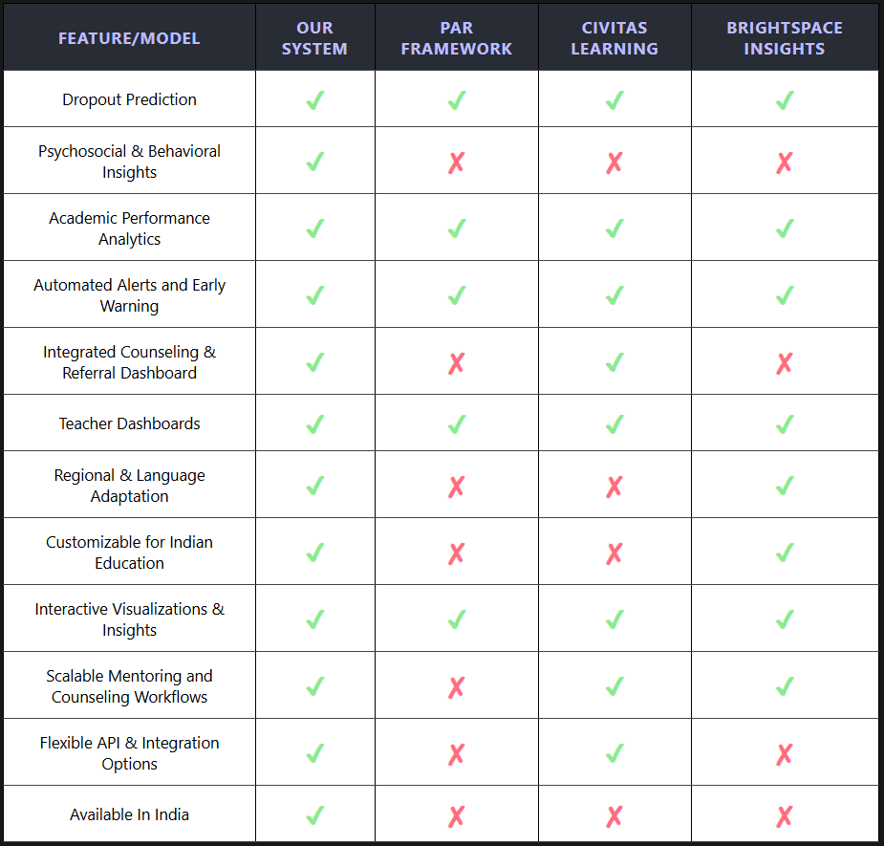
RESEARCH AND REFERENCES
Code-Z
Code-Z
https://www.civitaslearning.com/
https://community.d2l.com/brightspace/kb/articles/4543-about-insights-dashboards
https://er.educause.edu/articles/2013/12/the-predictive-analytics-reporting-par-framework-wcet
https://www.sciencedirect.com/science/article/pii/S1877050924034161

